Slide 1
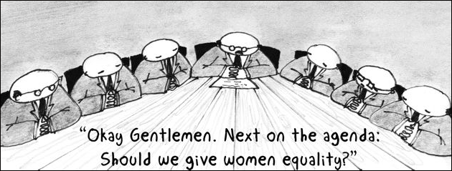
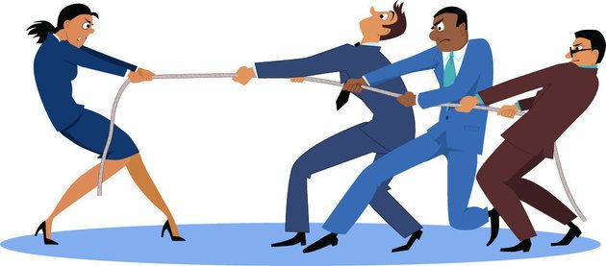
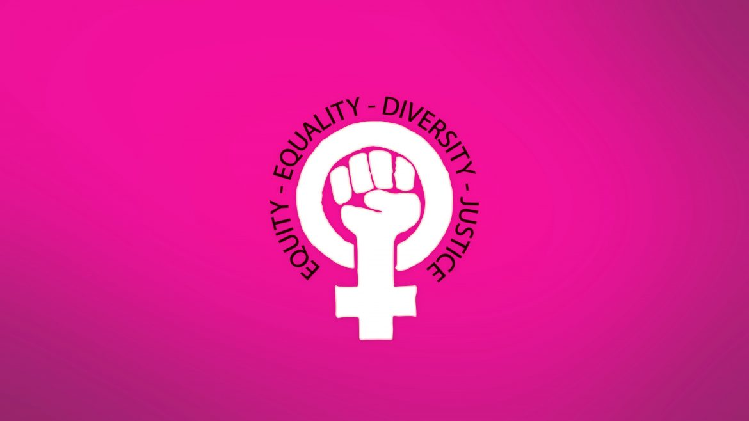

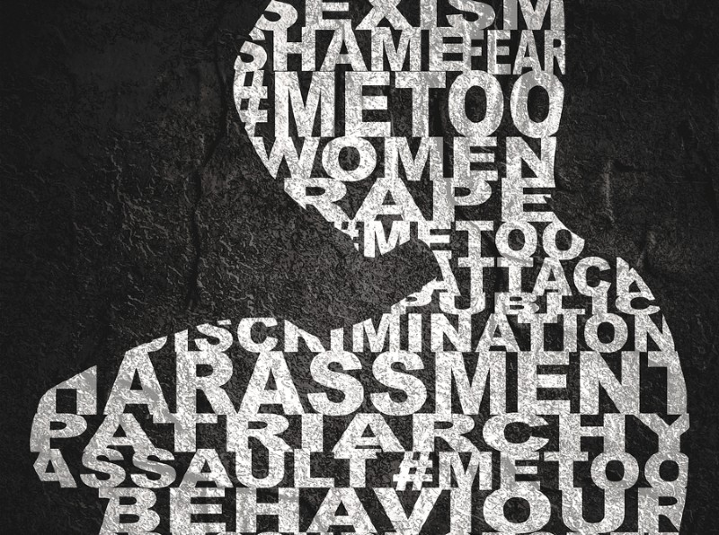
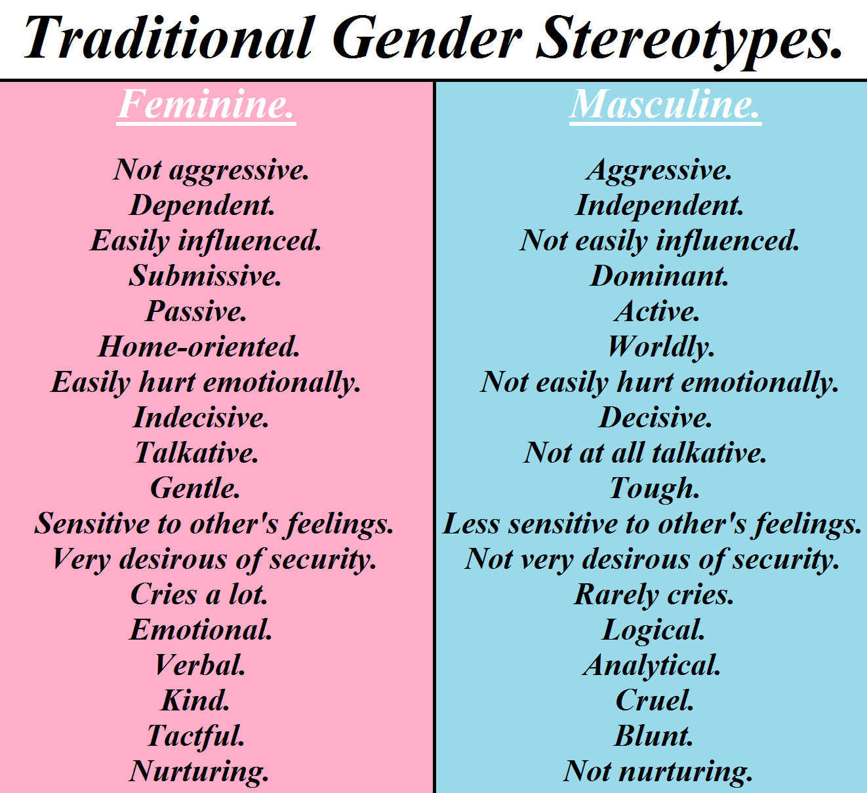
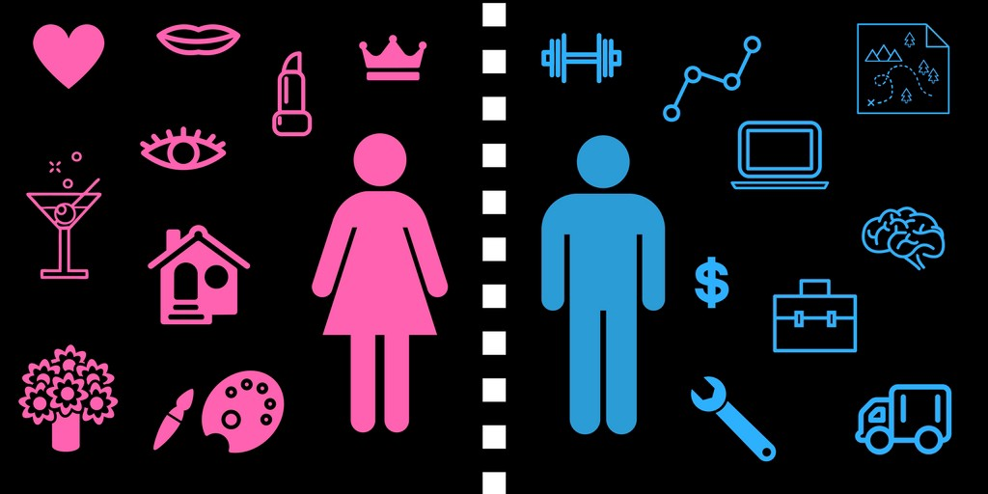
References:
Patriarchy and Gender Roles
Yoh Tha
Chaudhary, Siddhi. 2019. Feminism And Patriarchy: Social Political Philosophy. YouTube: Testprep. https://www.youtube.com/watch?v=9F4c01EUXa0
Crompton, Rosemary, Linda Hantrais, and Patricia Walters. 1990. "Gender Relations And Employment." The British Journal of Sociology 41(3):329. 10.2307/590962
Salem, Rania, and Kathryn M. Yount. 2019. "Structural Accommodations Of Patriarchy: Women And Workplace Gender Segregation In Qatar." Gender, Work & Organization 26(4):501-519. 10.1111/gwao.12361
Yoon, Eunju et al. 2015. "Development And Validation Of The Patriarchal Beliefs Scale.." Journal of Counseling Psychology 62(2):264-279. 10.1037/cou0000056
Description of Research
Patriarchy as an ideology and its influences over gender roles
Core principles of Patriarchy as defined within gender studies
What is Patriarchy?
a social system based on the premise that the male is superior to the female, so therefore, the power of authority resides in father, brother, husband, or any male members of a family. The male figure has the authority of power in the social, economic, political, and all spheres of the family life. It means they have the right to make decisions concerning the family over the females and younger males. (Salem, Rania, and Kaythryn M. Yount., 2019)
Patriarchy Reinforcing Oppression Intersectionality
Pay inequality between Male/Female
Unequal employment opportunities
Misogyny
(Chaudhary, 2019)
Methods/Policies
Feminism, a social movement whose philosophy is of equality among all beings and fights discrimination against women and minorities in all aspects
Major Elements
Core principles of Patriarchy as defined within gender studies
Gender roles created and supported by patriarchal ideology within our society
Ways in which patriarchy reinforces oppression intersectionality
Methods/policies proposed within gender studies in response against patriarchal ideology
Gender Roles Created and Supported
Instilled since birth
Influenced by family, friends, education, and society
For example, men looking for masculine/male jobs
such as the military, management, construction while
women looking for feminine/female job such a nursing,
medical, or cosmetics
(Crompton, Rosemary, Hantrais, and
Walters, 1990)
Conclusion
Patriarchy is still prominent in societies around the world
Fight against patriarchy by the Feminist movement for equality in all aspects of society
Patriarchy seen in todays society through inequality for women in all social and economical aspect
(Yoon, Eunju et al, 2015)

